Slide 1
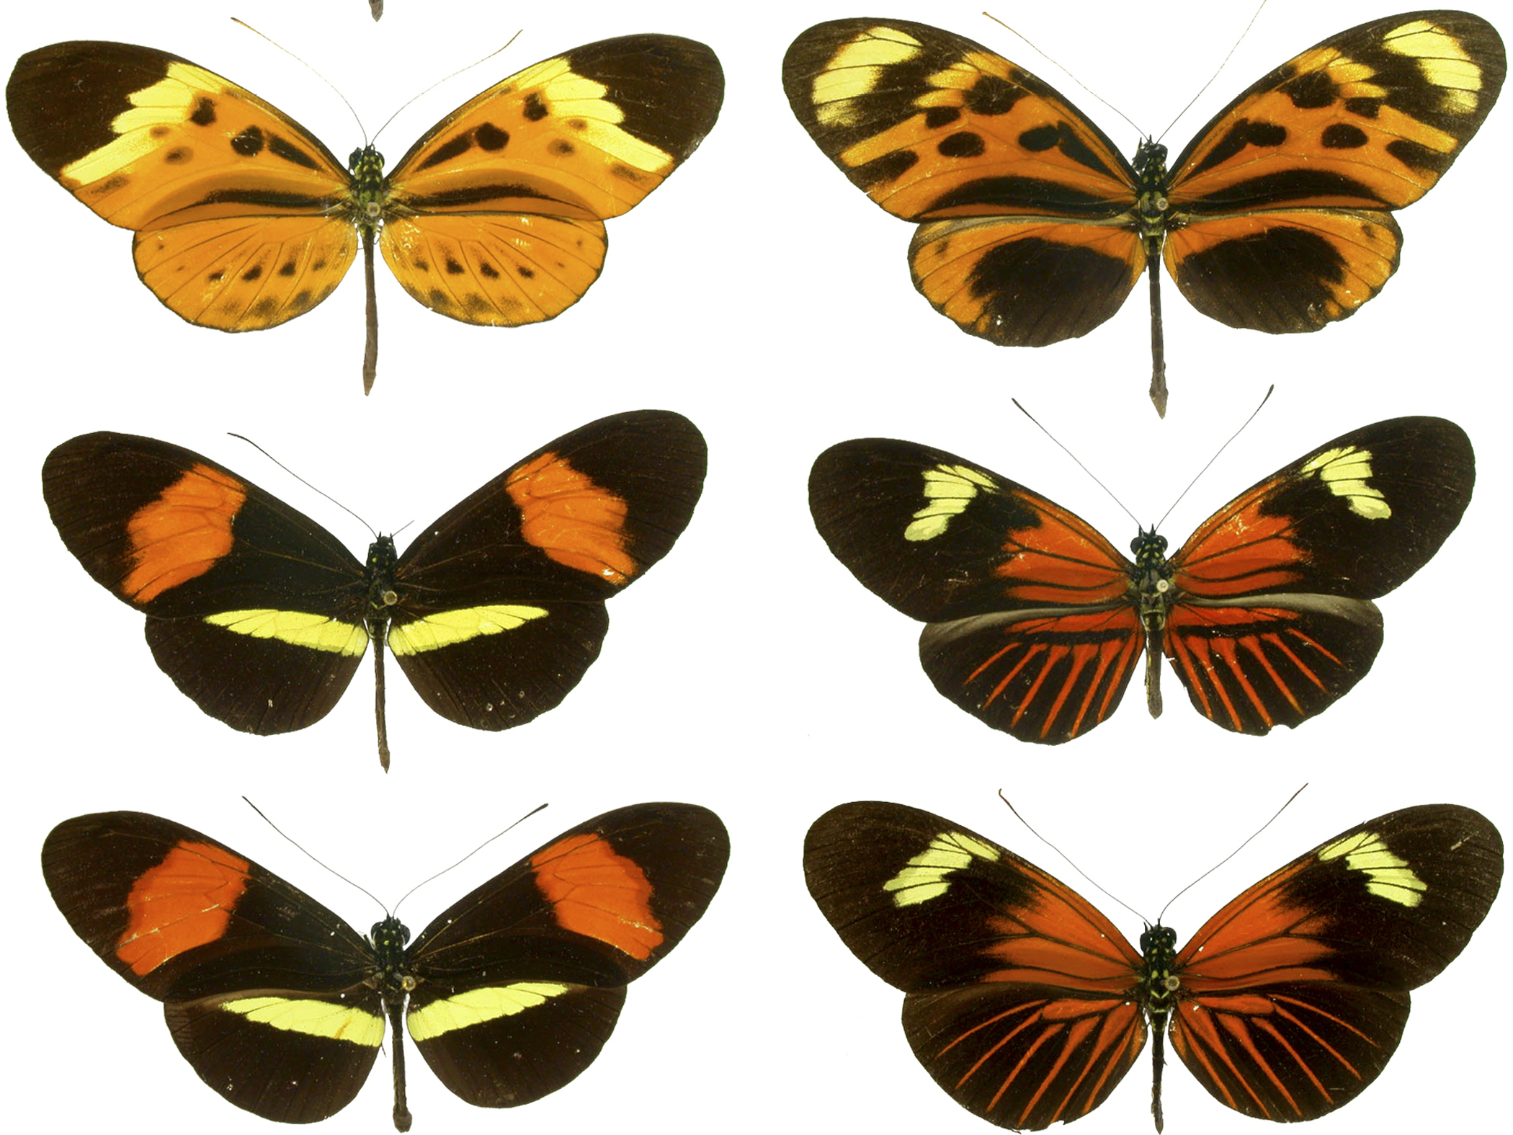


Avoiding Attack!

Slide 2
How can animals
(including us!) avoid “attack”?
1: Hide!

Slide 3
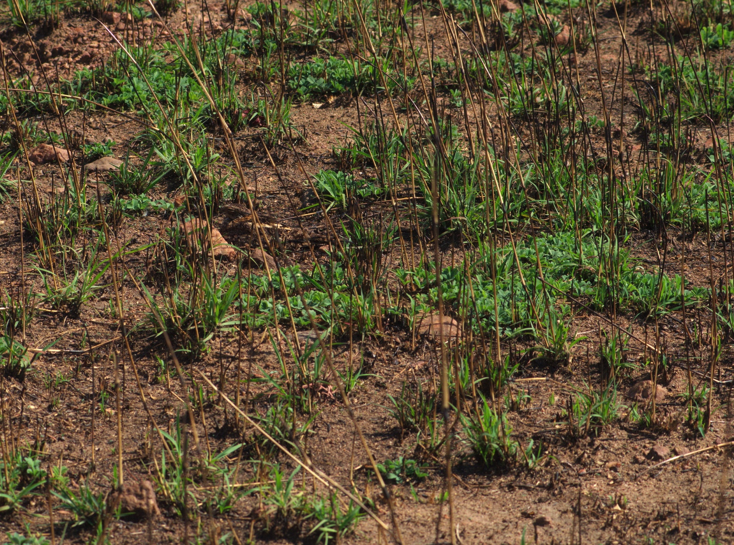
Image: Project Nightjar, http://bit.ly/1GhHf2a, CC-BY-SA
Notes:
The bird that you can see is a ground-nesting nightjar. These birds (and many other species) nest on the ground and therefore have to be very well camouflaged. The same is true of the nests and eggs.

Slide 4
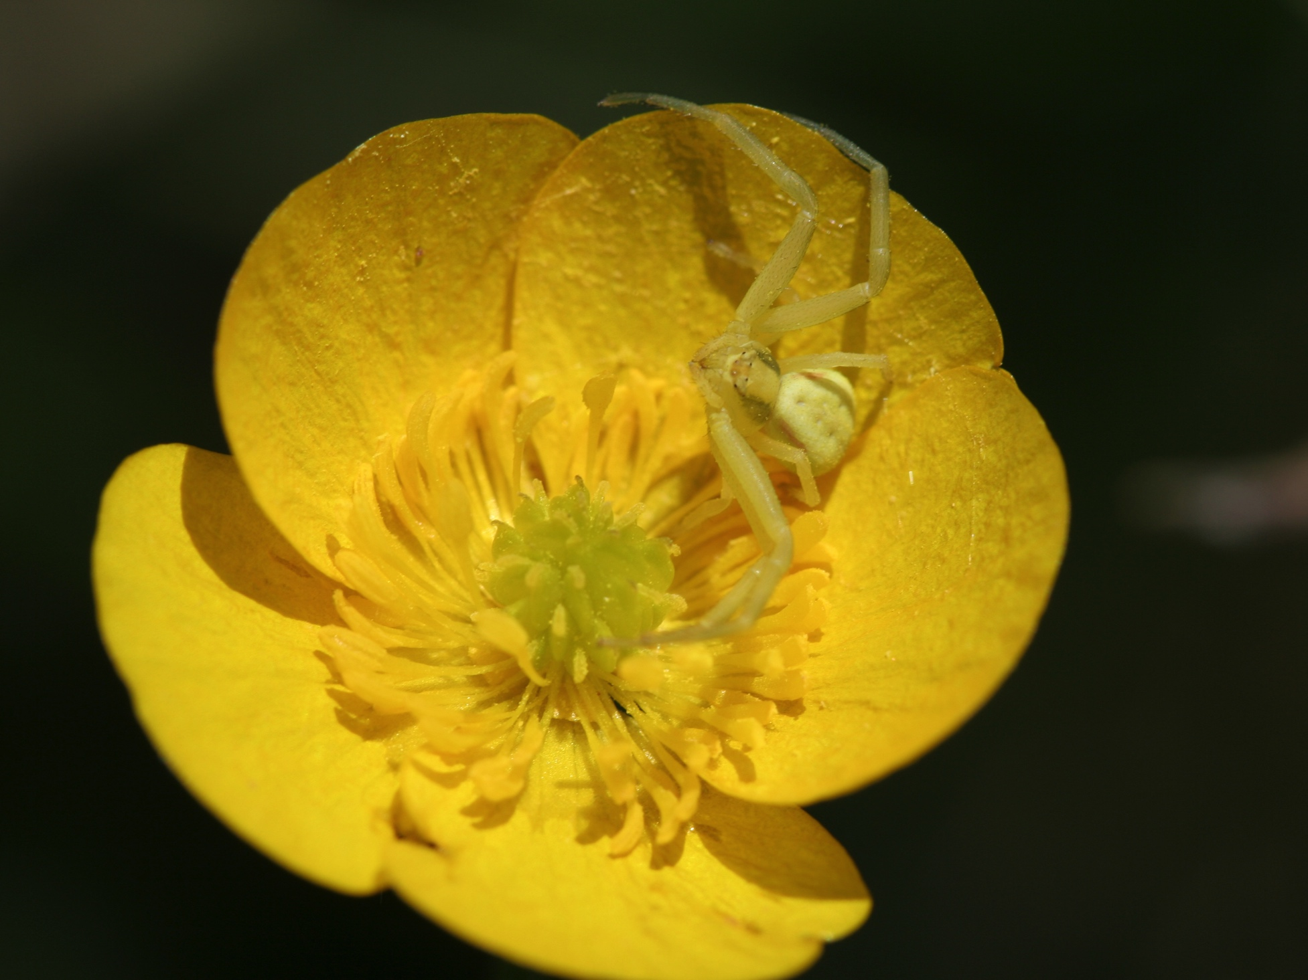
Image: Sharon Mollerus, http://bit.ly/1NOx583, CC-BY 2.0
Notes:
This is a crab spider camouflaged on a flower. Crab spiders sit and wait for bees and other pollinating animals to visit the flowers and then pounce and eat them.

Slide 5
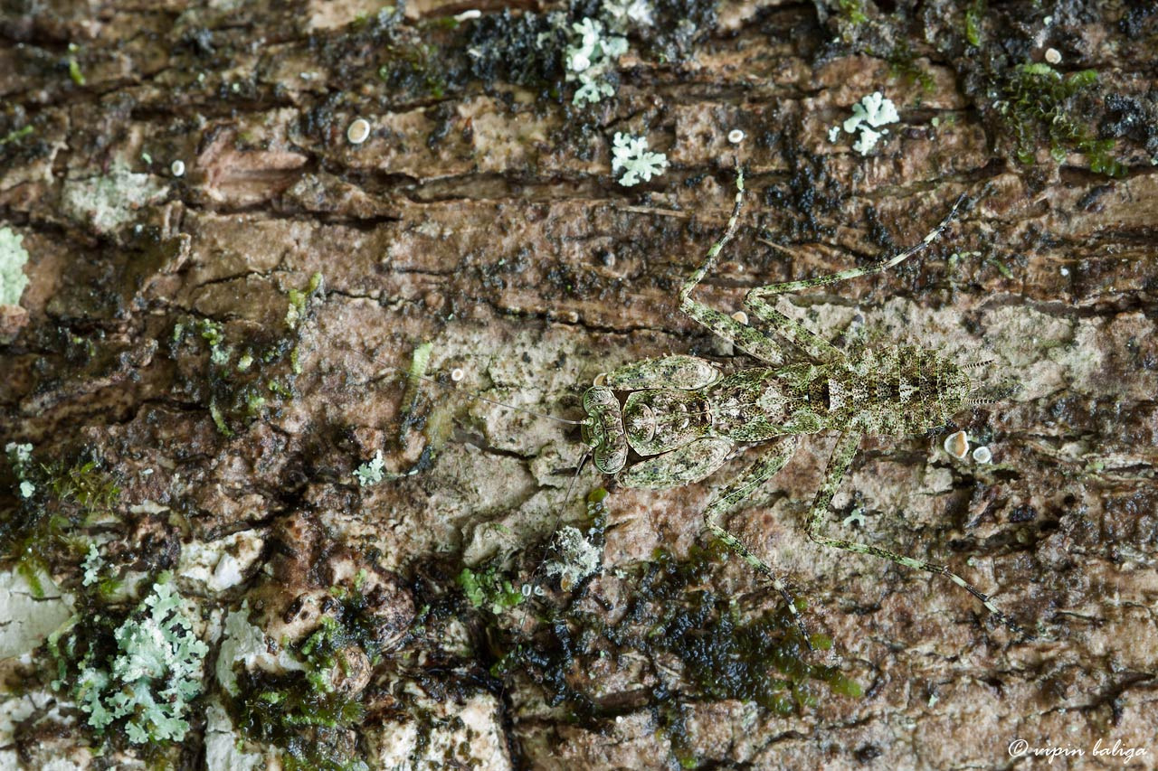
Image: Vipin Baliga, http://bit.ly/1CsGw6w, CC BY-NC-SA 2.0
Notes:
This is a bark mantis – another very well camouflaged predator that hides from its prey on trees.

Slide 6
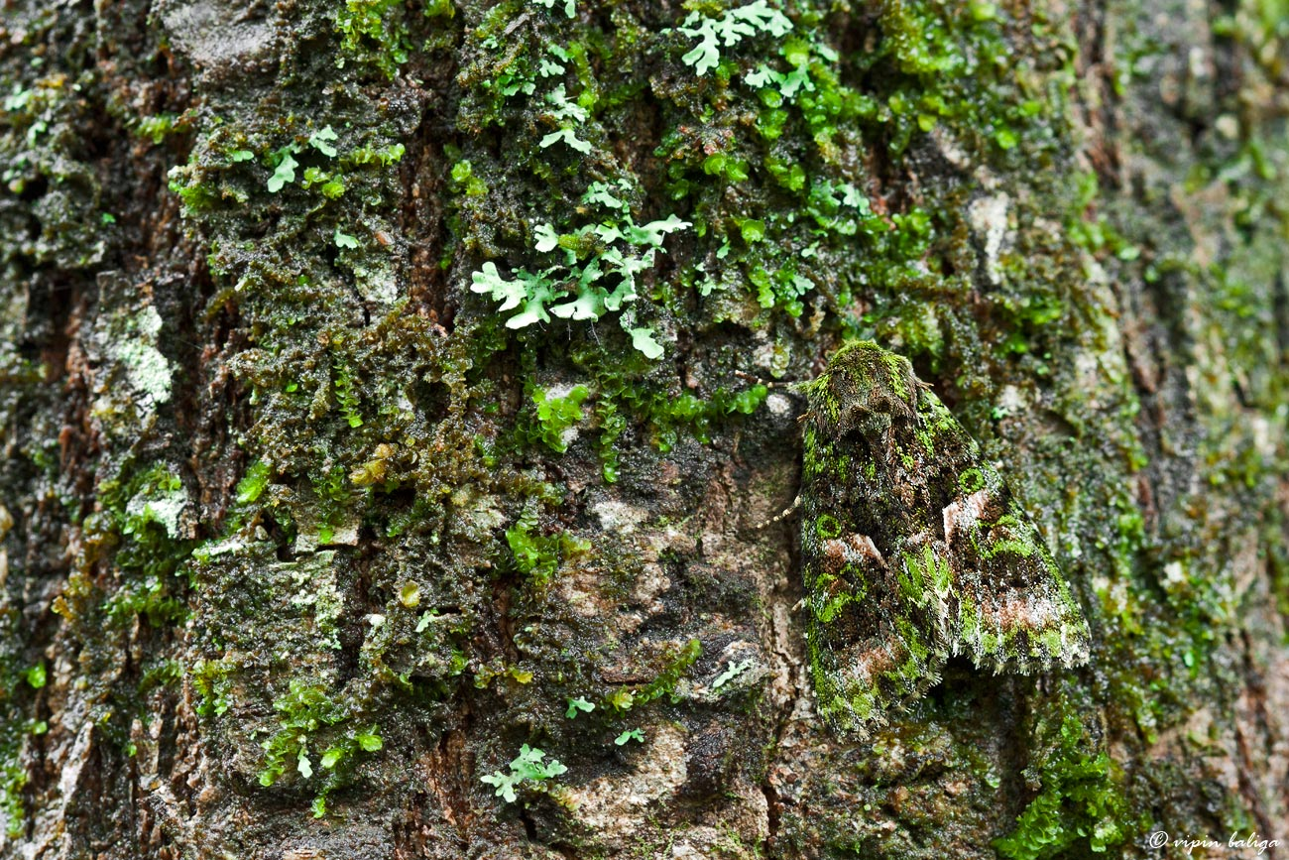
Image: Vipin Baliga, http://bit.ly/1CdcrIo, CC BY-NC-SA 2.0
Notes:
I’m afraid I can’t do any better than “a moth” for the identification of this species. It was spotted in the Western Ghats province of India. As with many moths, this species is remarkably well camouflaged on the tree bark amongst the moss and lichen.

Slide 7
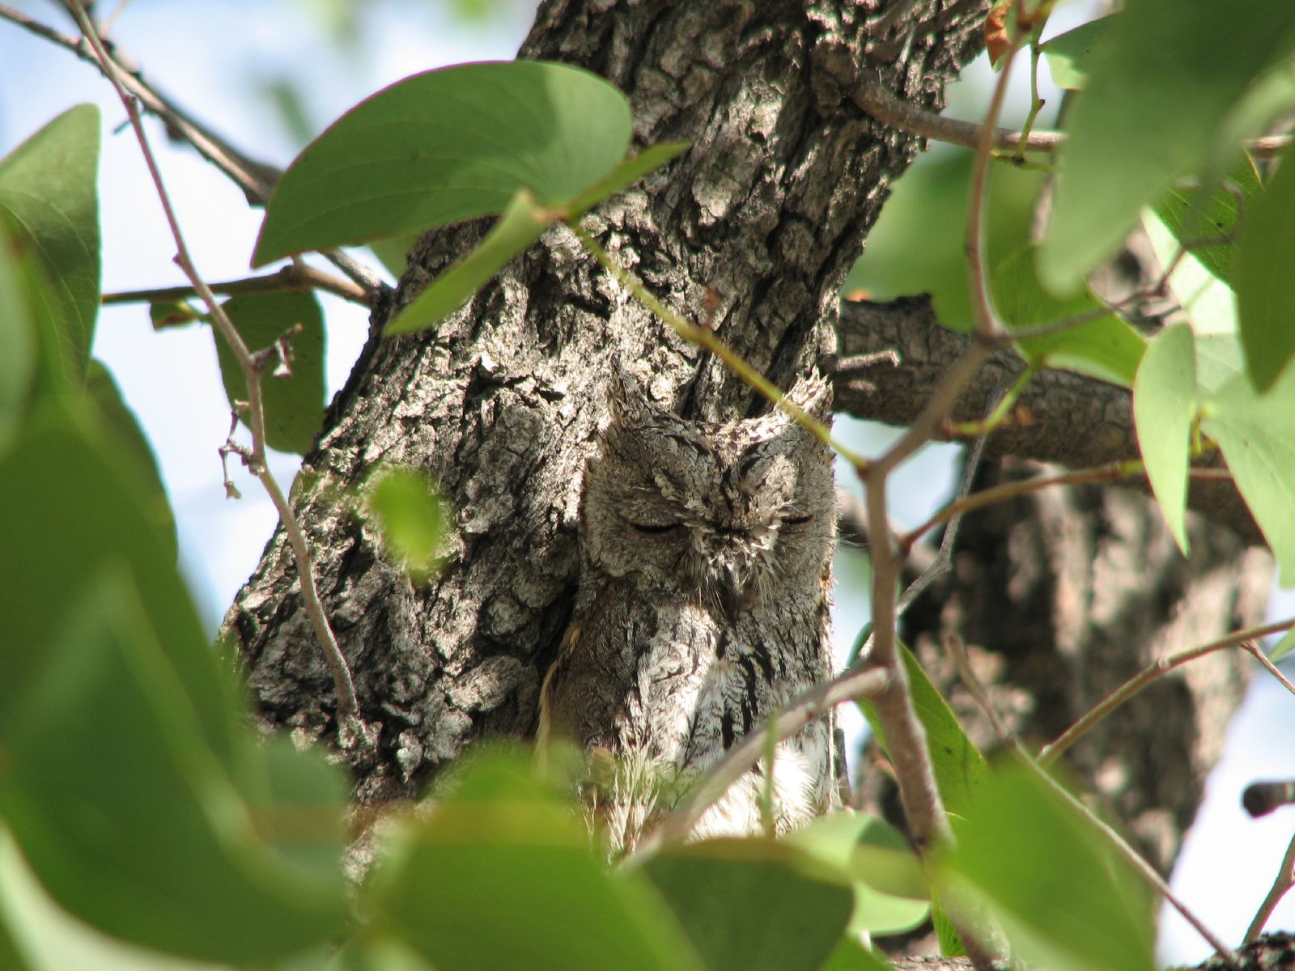
Image: Alastair Rae, http://bit.ly/1DFkQvk, CC BY-SA 2.0
Notes:
A Scops owl taking a nap in a tree. Owls are active at dusk and through the night, but they have to sleep somewhere. Being camouflaged means that they are less likely to be disturbed.

Slide 8
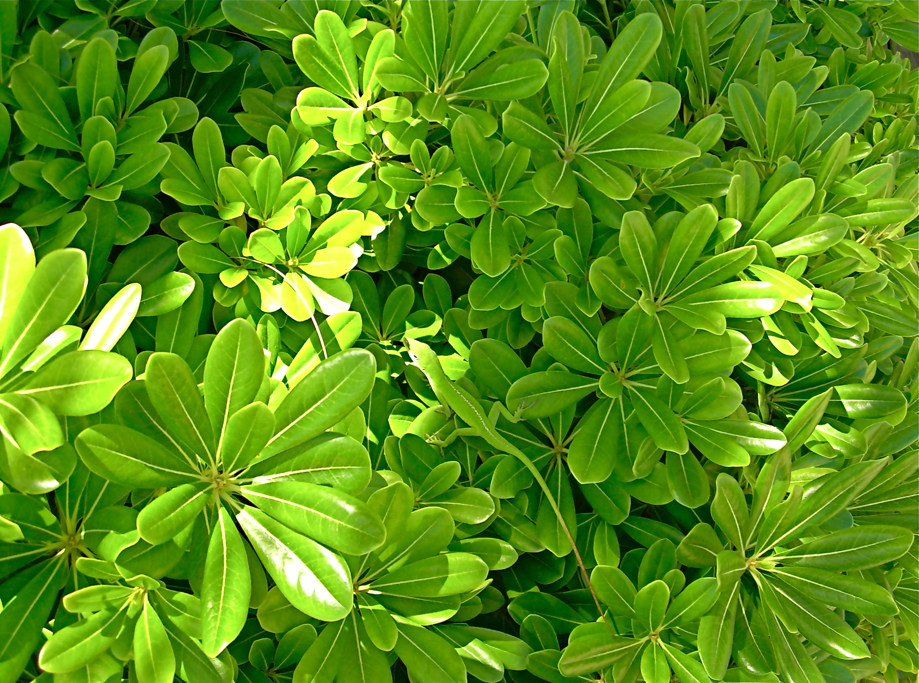
Image: Sanderslelli, http://bit.ly/1c1tkAB, CC BY-NC-ND 2.0
Notes:
This lizard matches the background of the leaves so well that it can move around and remain partly hidden.

Slide 9
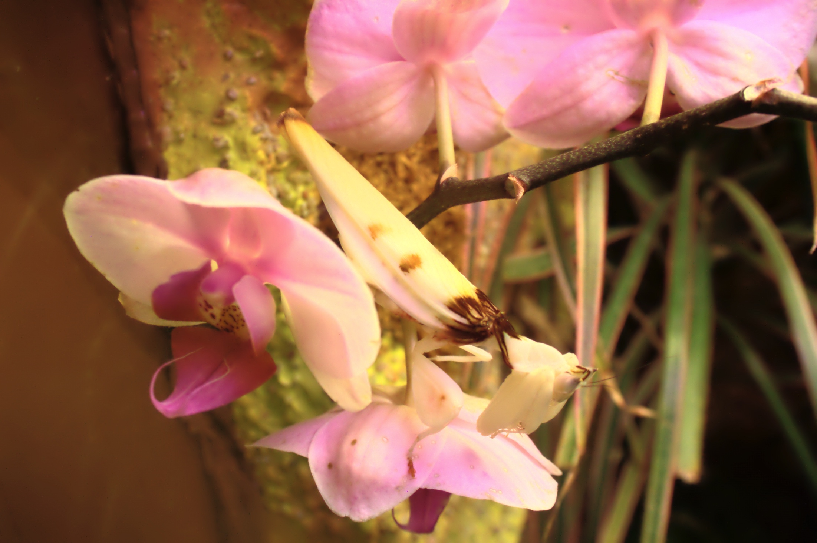
Image: Philipp Psurek, http://bit.ly/1IDJkTu, CC BY-SA 3.0
Notes:
An orchid mantis sitting on an orchid. Like the crab spider, this species sits and waits for passing insects and reaches out to grab them with its forelegs.

Slide 10
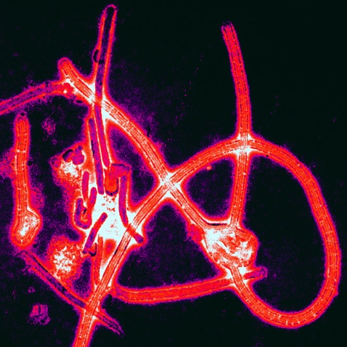
Image: Thomas W. Geisbert, http://bit.ly/1DFlAk3, CC BY 2.5
Notes:
This is a picture of the Ebola virus taken down a microscope. Ebola has many ways to hide from our body’s immune system, and in that way it can be said to have a form of camouflage. This is one of the reasons that Ebola is such a nasty disease.

Slide 11
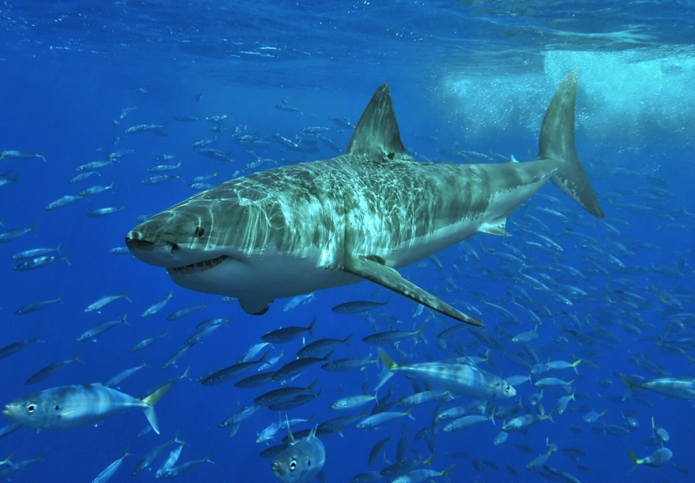
Image: Terry Goss, http://bit.ly/1MZv0uU, CC BY 2.5
Notes:
Everything from viruses to great white sharks can be said to have camouflage. You can ask the children why they think this might be an example of camouflage. The answer is that when a fish is looking at the shark from below it sees the white underbelly which blends in with the bright sky. When the fish is above the shark, the dark back of the animal blends in with the darkness in the bottom of the ocean. Great whites tend to hunt by swimming up beneath their prey.

Slide 12
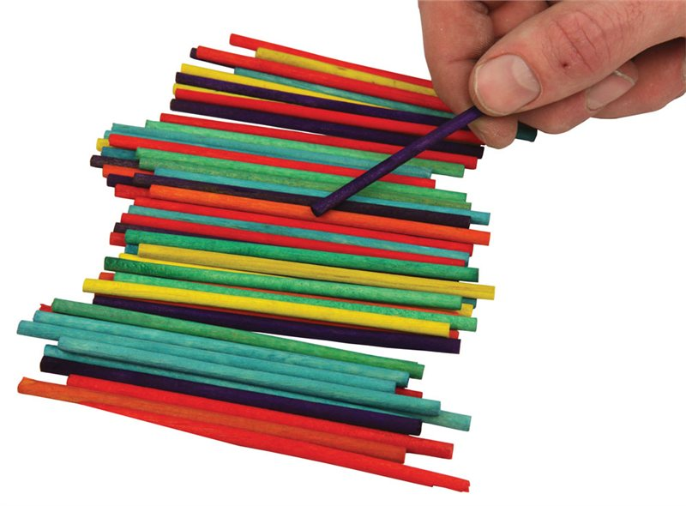
Experiment 1: Colourful camouflage

Slide 13
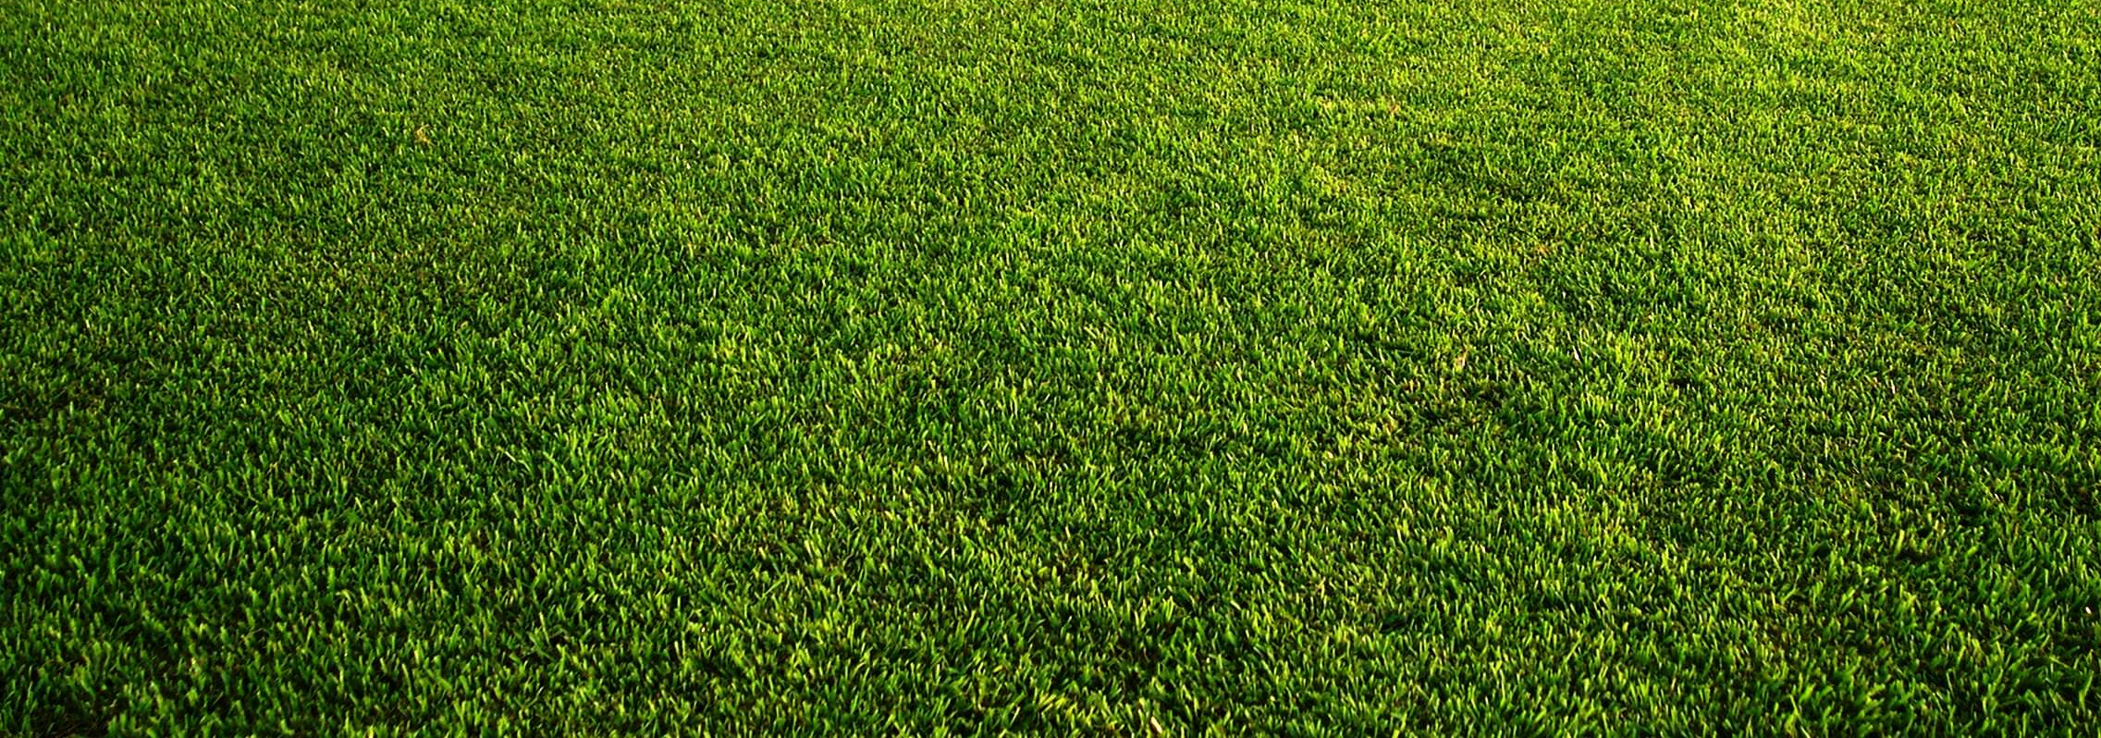
Five groups, one pot of 40 “prey” per group
  10 x red
  10 x green
  10 x purple
  10 x yellow
One group member scatters the prey
Another pupil collects 20 (I’ll show you how)
Take it in turns until everybody has scattered and collected
Enter your data back in the classroom
Experiment 1: Colourful camouflage

Slide 14
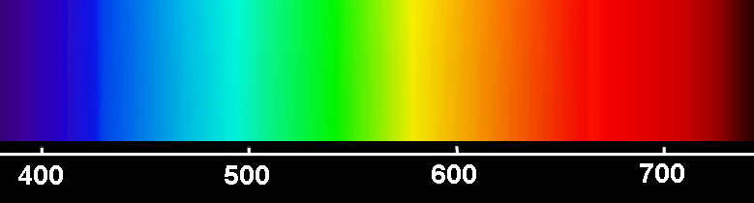
Hard to find!
Easier to find
Grass
Easier to find

Slide 15
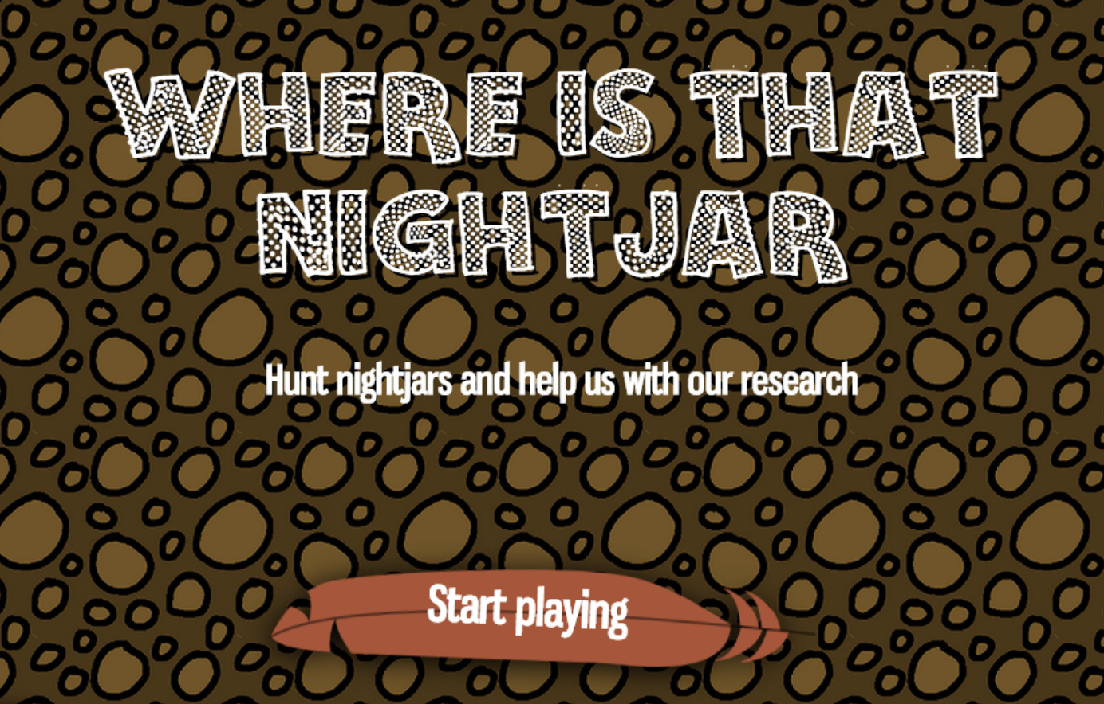
http://nightjar.exeter.ac.uk/story/nightjar_game
Notes:
Project Nightjar is a computer game designed by Martin Stevens and colleagues at the University of Exeter to test theories about the evolution of camouflage. Playing the game you will be shown a series of images and are tasked with trying to find the bird that is camouflaged in the scene. You can play along with the class, but please do click on the birds as soon as you find them so that the data is useful for the team.

Slide 16
How can animals
(including us!) avoid “attack”?
2: Pretend to be something else!

Slide 17
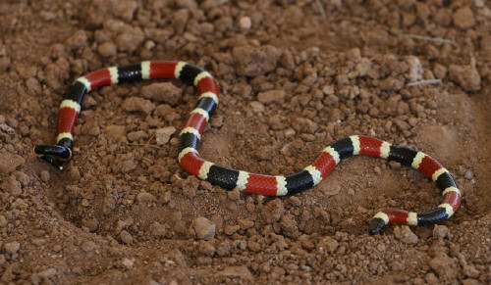
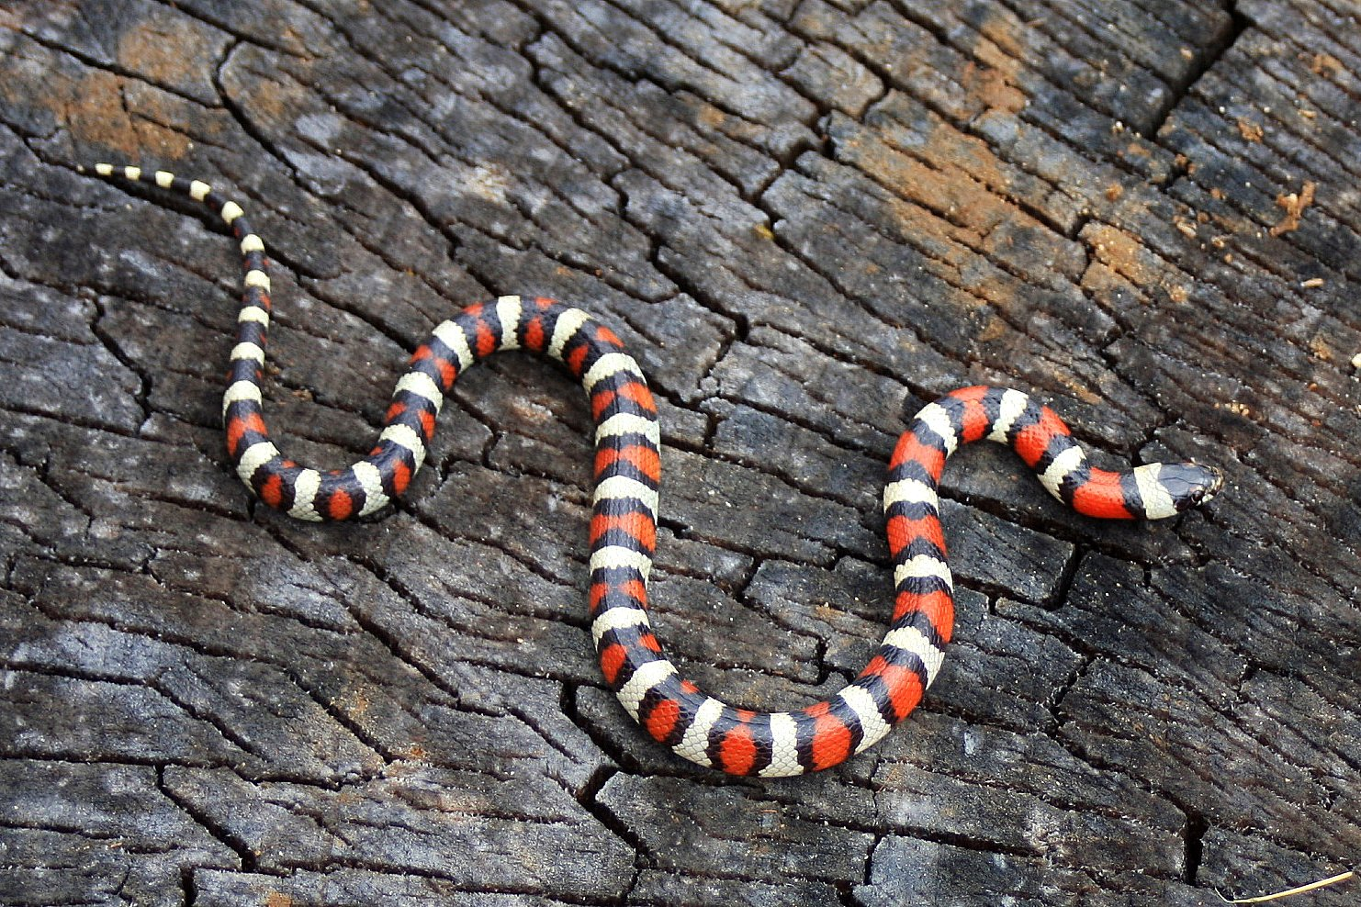
Images: reptilist, http://bit.ly/1DAyUD5, CC BY-NC-ND 2.0; J.N. Stuart, http://bit.ly/1Ehln6V, CC BY-NC-ND 2.0
Notes:
The top image is a coral snake which is venomous (though small, in this case, so not much danger to humans). The bottom image is a milk snake which is not venomous. There is a rhyme to remember the difference: “If red touches black, venom I lack; if red touches yellow, danger my fellow!” In these cases, the yellow markings are closer to white, but the same applies.

Slide 18
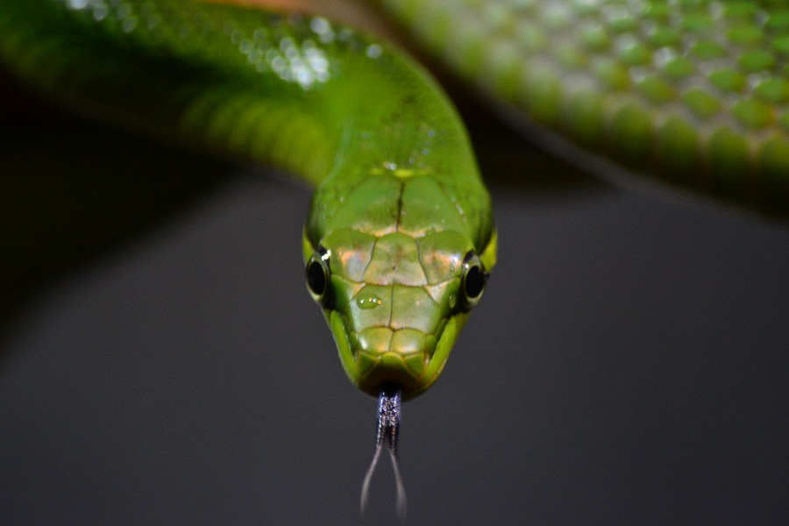
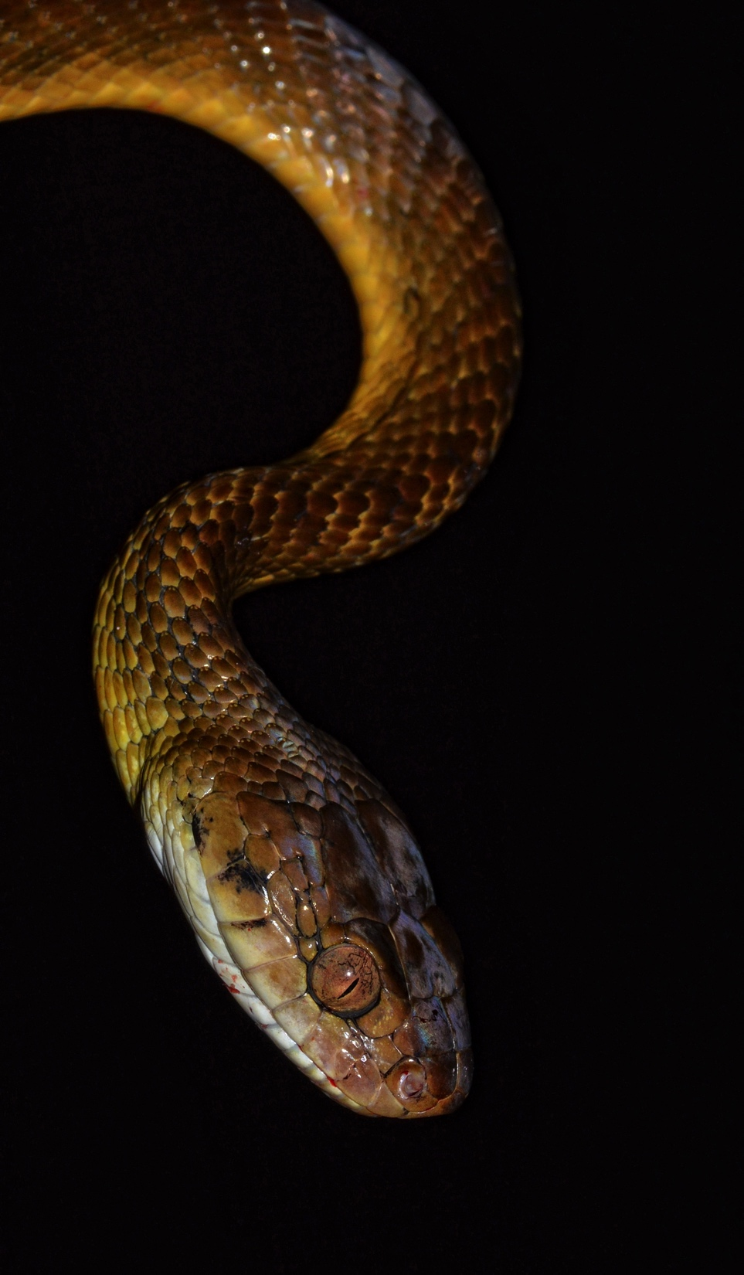
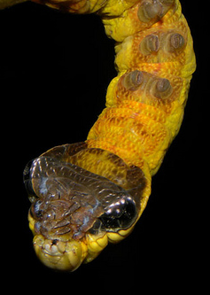
Images: Alexandre Roux, http://bit.ly/1DYh5zp, CC BY-NC-SA 2.0; Reinaldo Aguilar, http://bit.ly/1Q5XNx8, CC BY-NC-SA 2.0

Slide 19
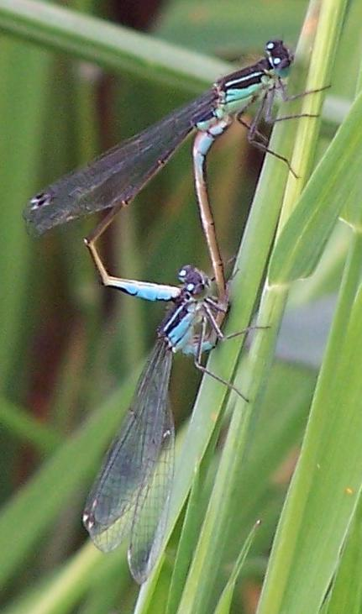
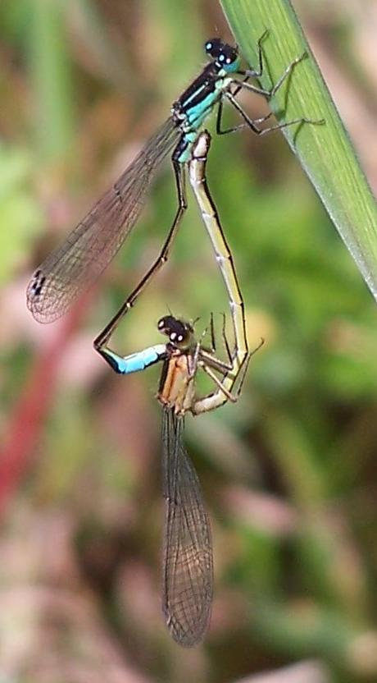
Image: Chris Hassall, http://bit.ly/1HIe1sI, CC BY 4.0

Slide 20
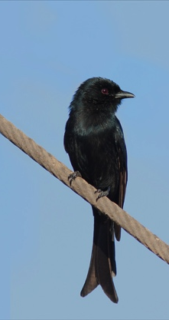
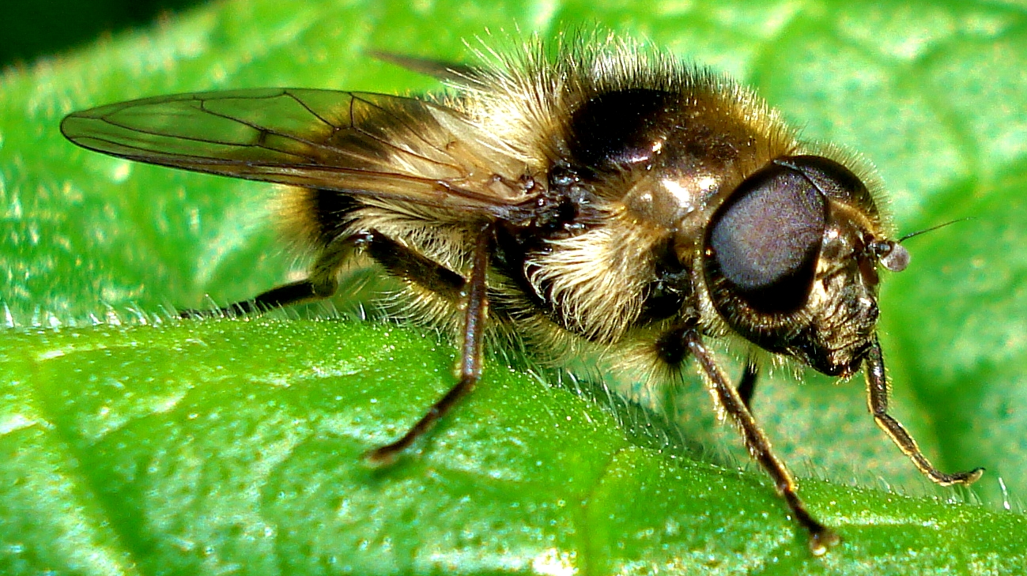
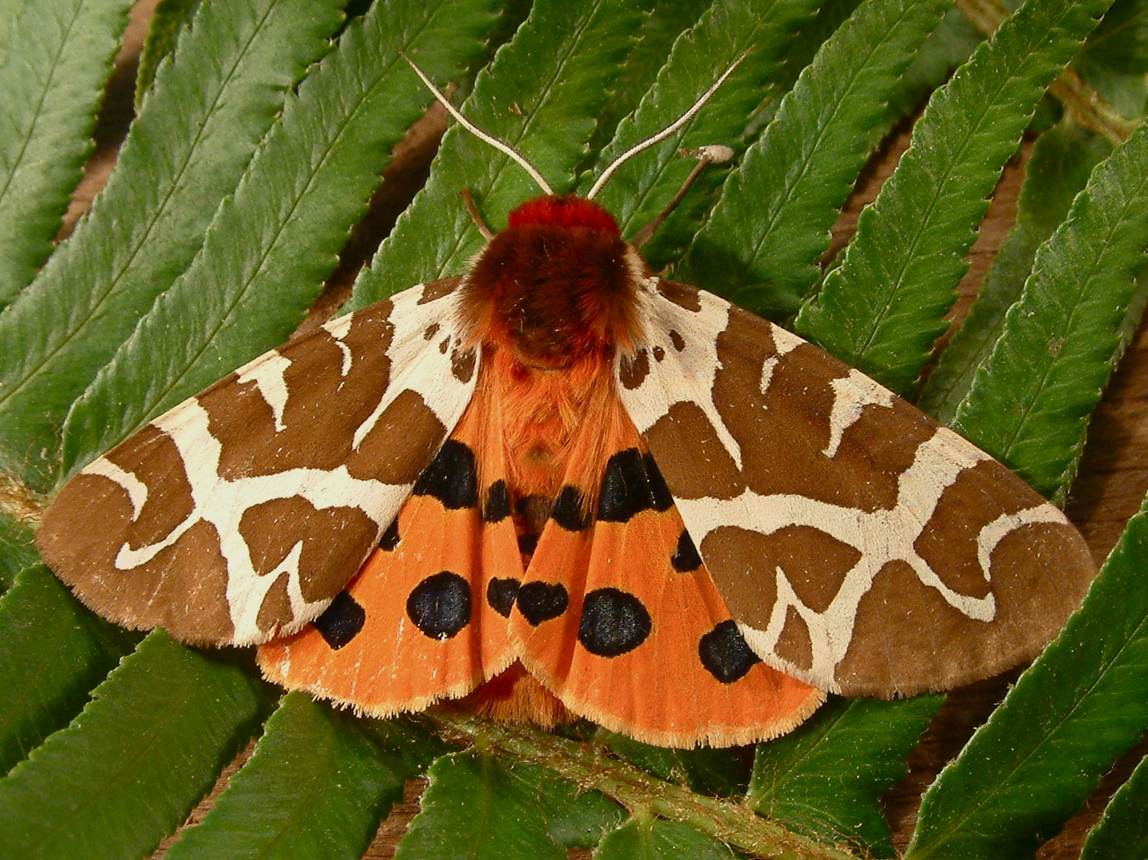
Images: Craig Adam, http://bit.ly/1OZxrLu, CC BY-NC-ND 2.0; Mick Talbot, http://bit.ly/1D2wn1W, CC BY-NC-SA 2.0; Dick Willapalens, http://bit.ly/1DA0W1z, CC BY-NC-SA 2.0.
Notes:
These three animals all have a different form of mimicry: they mimic the noises of other animals. The bird is called a “drongo”. This species hangs around meerkat burrows and waits until a meerkat has found something to eat. The drongo then mimics the distinctive meerkat alarm call, causing the meerkat to panic, drop the food and run for its burrow. The drongo then swoops down and carries off the food. The insect is the top right is a hoverfly called Cheilosia illustrata. As well as looking quite a lot like a bee, this species also makes a buzzing sound when it is disturbed that is very bee-like. That might be enough to put off a curious bird. The moth is a tiger moth. Some tiger moths have nasty toxins that make birds ill if they eat them and so the moth is brightly coloured to demonstrate this. However, the moths are also eaten by bats at night when the visual signal is no use. The poisonous moths have developed an ultrasonic click that warns the bats that they taste bad, and the moths that do not contain toxins mimic that same click.

Slide 21
Does it sting?

Slide 22
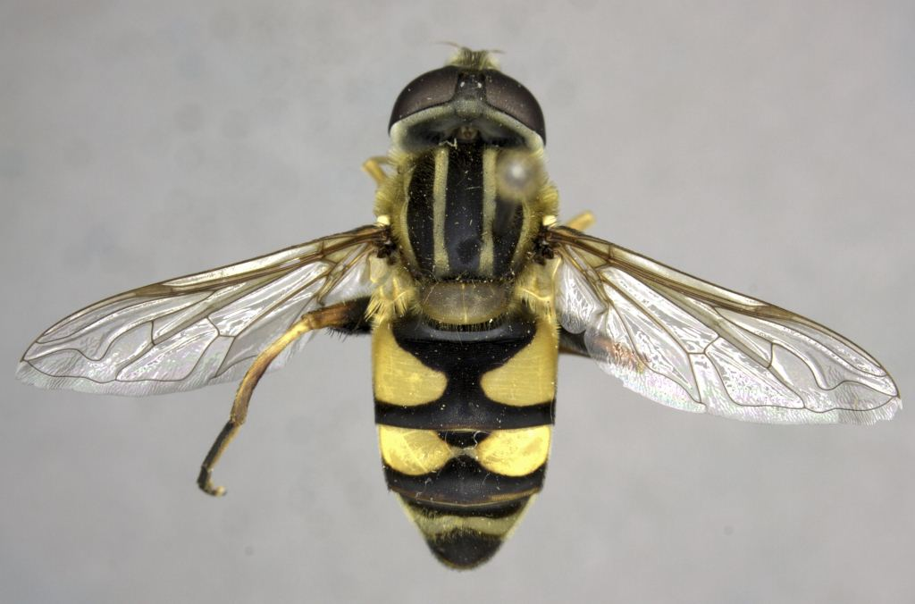
Image: Brent Lamborn, used with permission.
Notes:
Hoverfly

Slide 23
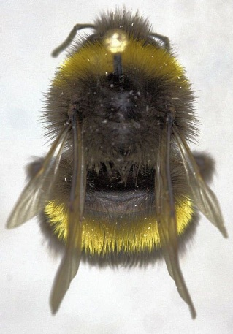
Image: Brent Lamborn, used with permission.
Notes:
Bumblebee

Slide 24
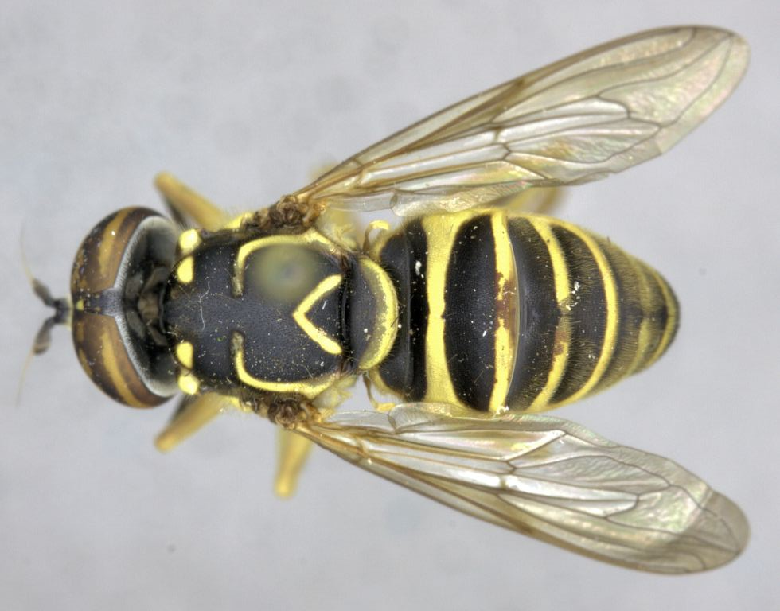
Image: Brent Lamborn, used with permission.
Notes:
Hoverfly

Slide 25
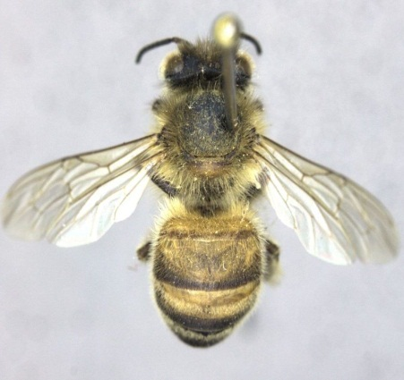
Image: Brent Lamborn, used with permission.
Notes:
Honey bee

Slide 26
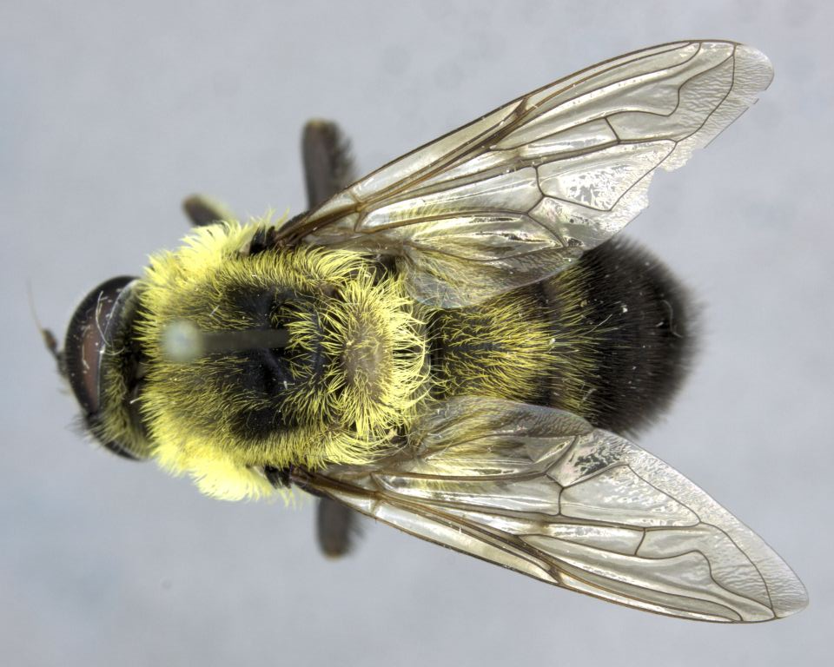
Image: Brent Lamborn, used with permission.
Notes:
Hoverfly

Slide 27
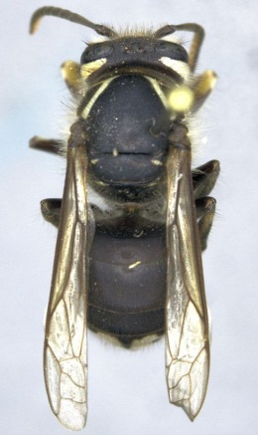
Image: Brent Lamborn, used with permission.
Notes:
Wasp (bald-faced hornet)

Slide 28
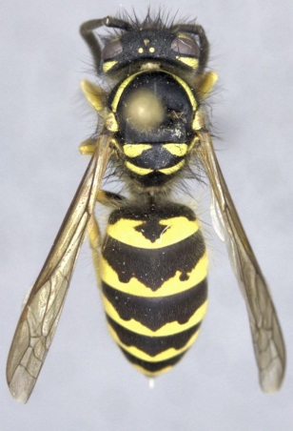
Image: Brent Lamborn, used with permission.
Notes:
Wasp

Slide 29
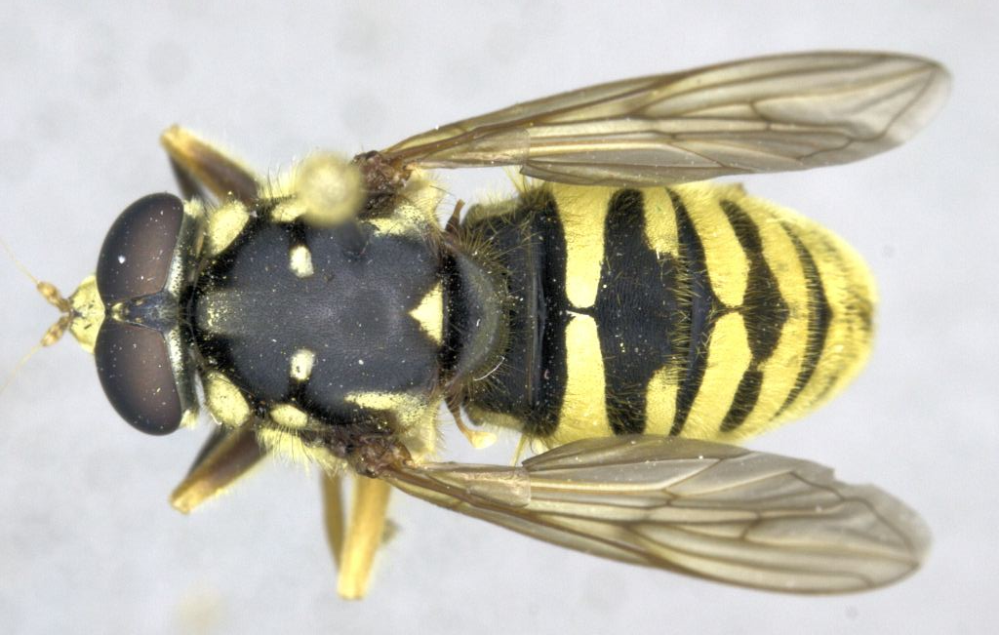
Image: Brent Lamborn, used with permission.
Notes:
Hoverfly

Slide 30
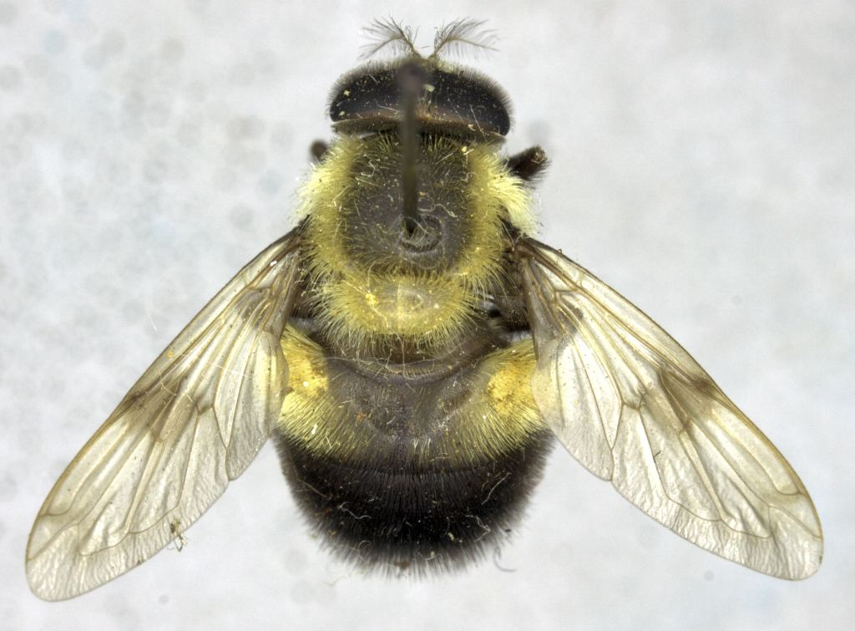
Image: Brent Lamborn, used with permission.
Notes:
Hoverfly

Slide 31
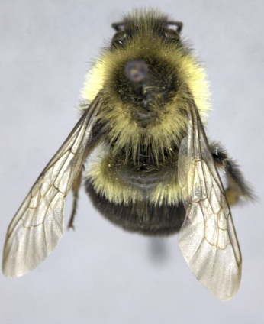
Image: Brent Lamborn, used with permission.
Notes:
Bumble bee

Slide 32
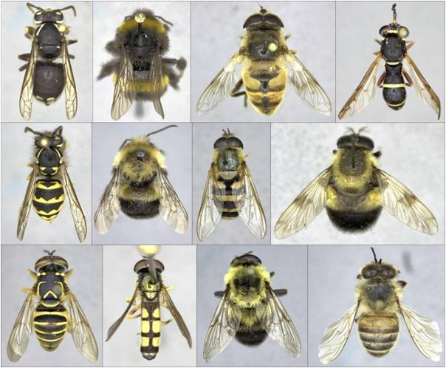
Image: Brent Lamborn, used with permission.
Notes:
And here are all the images side by side. You can see that a bird faced with all these animals has a very difficult job in trying to figure out which it can eat without being stung. There are five animals here that can sting, and seven that are perfectly safe to eat!

Slide 33
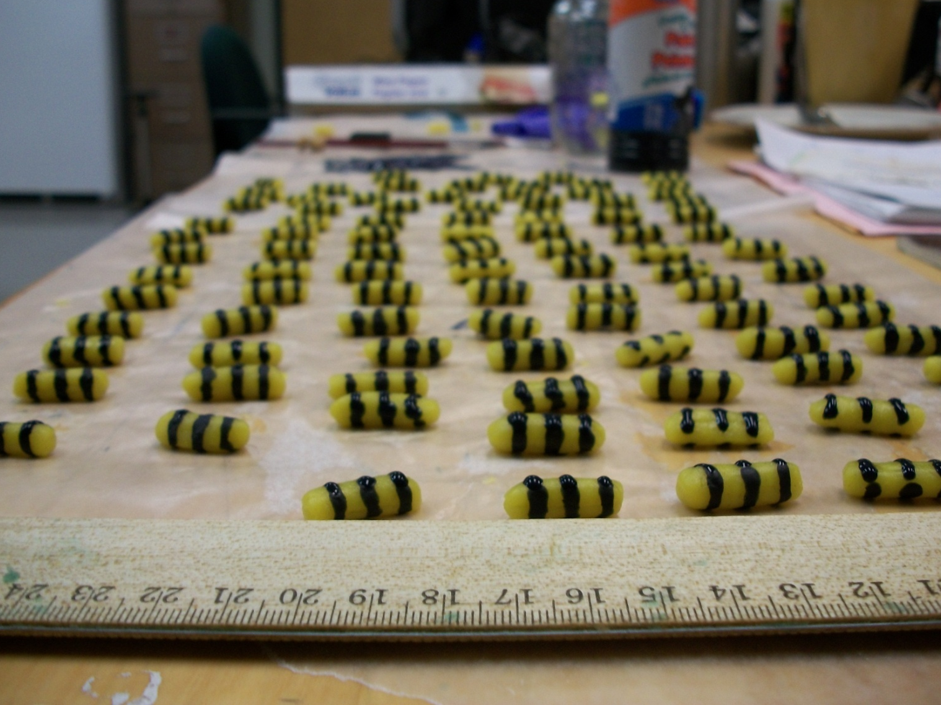
Image: Chris Hassall, used with permission.
Notes:
Researchers investigating mimicry can use artificial insects made from pastry and food colouring to test evolutionary ideas. These are then placed outside and we can see which kinds birds eat. It is also possible to put nasty-tasting chemicals in them (the same chemicals used to stop people biting their nails).

Slide 34
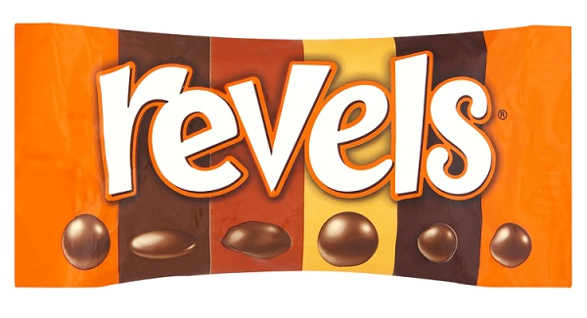
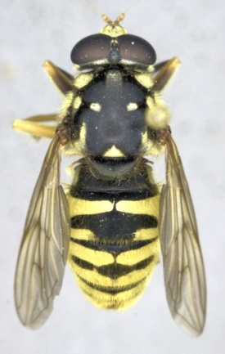
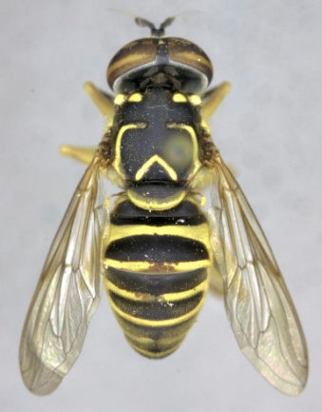

Experiment 2: Check your chocolates!

Slide 35
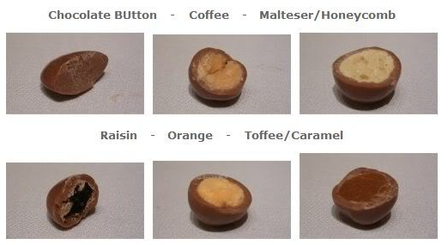
Five groups, one bag of “prey” per group
Each of you try three (and only three!) each and see if you like them – you can have the rest to share later if your teacher agrees!
Now try to identify the chocolates and decide which of the remaining chocolates you would eat
Take it in turns until everybody has scattered and collected
Enter your data back in the classroom
Experiment 2: Check your chocolates!

